Slide 1
DESIGN THINKING

Slide 2
A LITTLE BIT ABOUT ME
FULL Name
NICKNAME
COURSE
SOMETHING
INTERESTING

Slide 3
A LITTLE BIT ABOUT YOU
FULL Name
NICKNAME
COURSE
SOMETHING
INTERESTING

Slide 4

By the end of today…
• General design thinking
framework
• Needfinding tips
• Whole-group activity
Notes:
Image copyright: storyandstructure.com

Slide 5
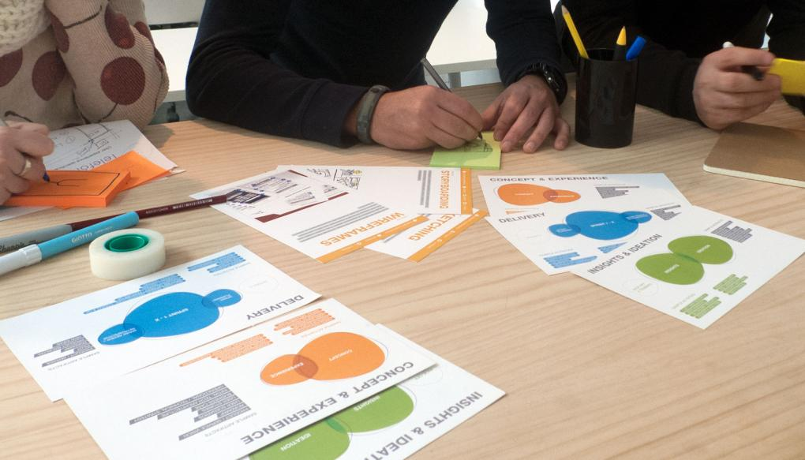
DESIGN THINKING
WHAT
WHEN
HOW
Notes:
Copyright: fjord

Slide 6
- an approach to solving design
problems by understanding
users’ needs and developing
insights to solve those needs.
A DEFINITION

Slide 7
- Only through contact,
observation, & empathy with
end-users can you hope to
design solutions that fit into their
environment.
DESIGN THINKING

Slide 8
“We have this technology. What can we use it for?”
“Our competitors just launched X. How can we do X quickly?”
THE USUAL QUESTIONS

Slide 9
DESIGN THINKING
WHAT
WHEN
HOW

Slide 10
- Developing & deploying a solution to a problem presented in your organization, or on your own.
WHEN?

Slide 11
DESIGN THINKING
WHAT
WHEN
HOW

Slide 12
There are different names for the steps, but same overall idea.
THE
PROCESS

Slide 13
Understand
Observe
Synthesize
THE PROCESS:
IN THEORY
Ideate
Prototype
Iterate

Slide 14
Understand
Observe
Synthesize
THE PROCESS:
IN PRACTICE
Ideate
Prototype
Iterate

Slide 15
Understand
Observe
Synthesize
UNDERSTAND
Ideate
Prototype
Iterate

Slide 16
Gain basic knowledge so you know the right questions to ask.
THE GOAL

Slide 17
• Web research (go beyond Google)
• Brief interviews for background
• Reach out to friends who may be
connected/have information on
subject
METHODS

Slide 18
• More questions than answers
• Know what has come before in this topic and what the main open questions are
At the end of
this step…

Slide 19
Understand
Observe
Synthesize
OBSERVE
Ideate
Prototype
Iterate

Slide 20
Gain empathy with your target users by talking and observing them.
THE GOAL

Slide 21
• Watch what they do, not what they say.
• “If I had asked people what they wanted, they would have said faster horses.” – Henry Ford (…maybe)
JUST ASK THEM

Slide 22
• You need to understand your audience even better than they understand themselves.
AS A DESIGNER…

Slide 23
• the only way you will get there is to develop a deep empathy for their habits, beliefs, quirks, and workarounds.
BUT…

Slide 24
WHY?
THE KEYWORD

Slide 25
• Keep asking “why” until it is unbearably awkward.
• Then ask it one or two more times.
WHEN INTERVIEWING…

Slide 26
A: I never leave the house without my phone.
Q: Why’s that?
A: Oh, I’m worried that I’ll miss something fun by being out of touch.
Q: That’s interesting. Why does that worry you so much?
A: Well, my group of friends never plans anything. It’s all very last minute.
Q: Oh, why do you think you all do not plan much?
A: I think it’s because it’s sort of uncool to be too on top of things. I keep two separate Google Calendars, one has my real appointments and the other one is mostly empty so it doesn’t look like I over-plan.
Q: Why…
EXAMPLE

Slide 27
• Surprises!
• Test: Is this interesting enough to tell a stranger?
WHAT ARE WE LOOKING FOR?

Slide 28
• “This person I talked to never leaves the house without a phone”
(not very surprising and compelling. A bit boring if you ask me)
• “This person I talked to actually keeps two separate Google Calendars, one for herself that’s full of appointments and the other one for her friends to think she is laid back and does not plan.”
(now, that’s more interesting)
BACK TO THE EXAMPLE

Slide 29
• Even less outgoing folks can profoundly surprise you when you get them talking about what they are interested in.
BUT THIS PERSON
IS BORING!

Slide 30
• When you interview a new participant and you can anticipate their answers, even when they are talking about detailed parts of what they do
WHEN DO I SAY, “ENOUGH”?

Slide 31
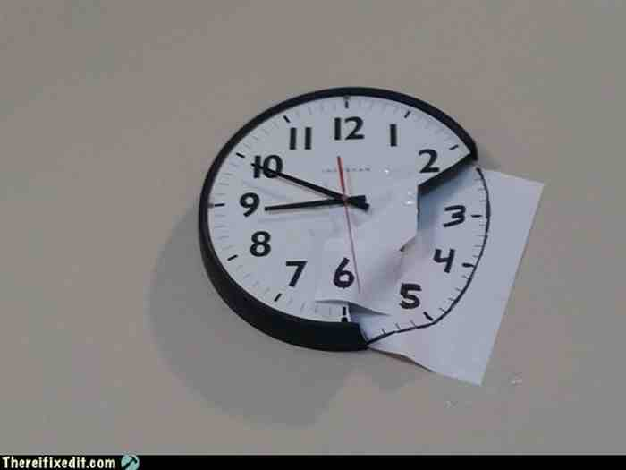
• Always look out for quirky workarounds
THINGS TO
OBSERVE

Slide 32
• Behaviors that people do over and over again throughout the day.
THINGS TO
OBSERVE

Slide 33
Understand
Observe
Synthesize
SYNTHESIZE
Ideate
Prototype
Iterate

Slide 34
Come up with a point-of-view statement around which your prototyping will revolve.
WHY?

Slide 35
• POV statements can be thought of as:
user + need + insight
GETTING TO A
POINT OF VIEW

Slide 36
• from Neema Moraveji, Education PhD student at Stanford
EXAMPLE

Slide 37
• Children in classrooms in developing nations
USERS

Slide 38
• Often only a few computers for the whole classrooms, so students can’t all use one computer
NEED

Slide 39

• By sharing one screen and allowing for multiple mice on that computer, all can play together
INSIGHT

Slide 40
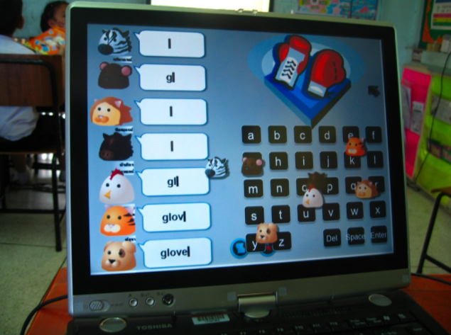
• By sharing one screen and allowing for multiple mice on that computer, all can play together
INSIGHT

Slide 41
• One Laptop Per Child (OLPC) Project
SIMILARLY

Slide 42
• Children in classrooms in developing nations
USERS

Slide 43
• Often only a few computers for the whole classrooms, so students can’t all use one computer
NEED

Slide 44
• By reducing the cost of producing computers, we can increase access to them.
INSIGHT

Slide 45
• Your point-of-view should have an enormous impact on what you ultimately design
• Later discoveries might lead you to come back and revise your POV
IMPACT

Slide 46
Understand
Observe
Synthesize
IDEATE
Ideate
Prototype
Iterate

Slide 47
• Based on your point-of-view, generate as many ideas as possible
THE GOAL

Slide 48
• Set yourself a time limit, and try to generate a minimum of ideas (50 ideas in 60 minutes)
• Come together as a team after activity, and brainstorm together
ACTIVITIES

Slide 49
Understand
Observe
Synthesize
PROTOTYPE
Ideate
Prototype
Iterate

Slide 50
• Make your ideas real and learn from people’s reactions to your prototype
THE GOAL

Slide 51
• Two most important things are:
Rapid
Focused
ON PROTOTYPES

Slide 52
• Every prototype should answer a question
What does it feel like to hold this object?
What should the flow of screens be in an interactive prototype?
RAPID & FOCUSED

Slide 53
• Users look at lo-fi prototype and see potential; they look at a hi-fi prototype and see problems
BENEFITS OF
LO-FI

Slide 54
• Try to find proxy users if our ideal audience is not available
• Introduce your prototype and any background on the current design problem
• Come up with 2-3 tasks that you would like to perform with your prototype
GETTING USER FEEDBACK

Slide 55
• One way of structuring feedback; ask users 2 things they liked about the prototype and 1 thing they wish it did differently
I LIKE, I WISH

Slide 56
Understand
Observe
Synthesize
ITERATE
Ideate
Prototype
Iterate

Slide 57
• Take insights gained from prototyping and revisit your assumptions; sometimes you might go all the way back to the Understand phase
THE GOAL

Slide 58
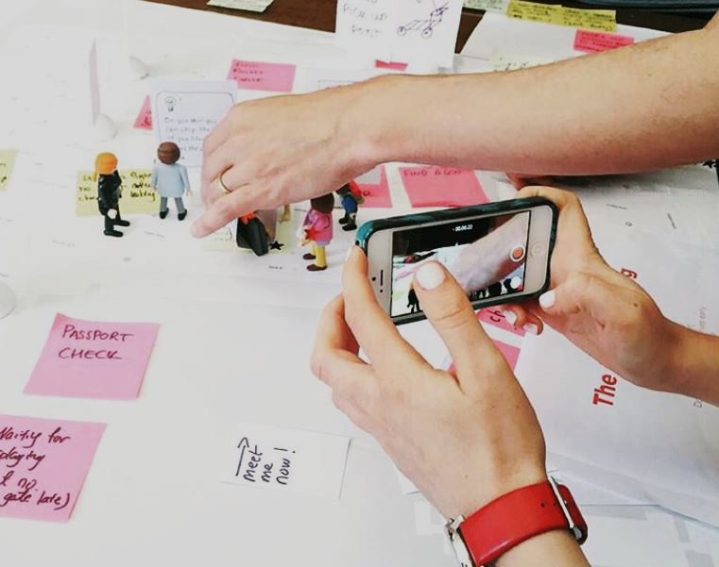
DESIGN THINKING
ACTIVITY

Slide 59
• Pair up with the person next to you
• For 5 minutes, describe your ideal wallet to your partner (and show them your current one); the, switch
• Using the user + need + insight technique, rapidly prototype a wallet that meets your partner’s needs
OUTLINE

Slide 60
Resources
Visit the Community of Practice and engage on the Stream: https://kxsites.accenture.com/groups/DT/default.aspx
Online Guides and Libraries of Methods:
Fjord Library of Design Methods
Stanford dSchool Methods – a collection of methods for people new to design thinking, and a guide from Stanford’s Design Thinking “Bootleg” workshop
IDEO DesignKit – IDEO.org’s platform
Service Design Tools – Collection of design tools
Books:
This is Service Design Thinking: Basics, Tools, Cases by Marc Stickdorn and Jakob Schneider
Designing for Growth: A Design Thinking Toolkit for Managers by Jeanne Liedtka and Tim Ogilvie
101 Design Methods: A Structured Approach for Driving Innovation in Your Organization, by Vijay Kumar
Copyright © 2017 Accenture All rights reserved.

Slide 61
THANK YOU FOR TUNING IN!

